Slide 1


Research Ethics, Compliance, IRB, & IACUC
Presented by:
Joanne Muratori & Patria Davis

Slide 2
Agenda
Objective
Review history, role, and function of the Institutional Review Board
Review federal definition of human subjects research and levels of review
Understand how the IRB review and approval process relates to other ORC office functions
Research Ethics, Compliance, IRB, & IACUC

Slide 3
IRB Function
The purpose of an IRB is to review research involving human subjects to ensure their rights and welfare are adequately protected
Research Ethics, Compliance, IRB, & IACUC

Slide 4
Research ethics, Compliance, IRB, & IACUC: IRB Section
Role of the IRB Members
Charged with safeguarding the rights and welfare of human subjects.
Duties include reviewing protocols that involve the use of human subjects.
Assist and guide researchers to help protect the rights of human subjects
Research Ethics, Compliance, IRB, & IACUC

Slide 5
Why Do Human Research Subjects Need Protection?
Trigger Events
The Nazi Experiments
Tuskegee Syphilis Study
Milgram’s Studies
Rosenhan Studies
Laud Humprey’s
Research Ethics, Compliance, IRB, & IACUC

Slide 6
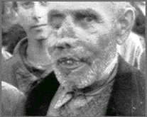
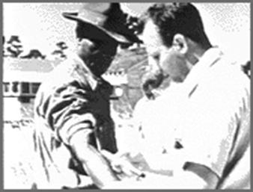

Trigger Events: “What we have learned from history…”
Nazi experimentation on concentration camp prisoners
Tuskeegee Syphilis Study
Milgram Study
Research Ethics, Compliance, IRB, & IACUC

Slide 7
Do we have a right to use information gathered unethically?
Prisoner of War camps in Asia and Europe:
Practiced mutilation surgery, tested antibiotics, affects of cold, injured people to study the healing process.
Research Ethics, Compliance, IRB, & IACUC

Slide 8
Tuskegee Experiments: Physical Harm
1932 took 625 black males and studied the course of syphilis.
425 were diagnosed as having syphilis and the remainder were used as a control.
In 1937 we discovered Penicillin but still did not give it to the men.
Research Ethics, Compliance, IRB, & IACUC

Slide 9
Milgram’s Studies: Deception, Emotional Harm
Participants were asked to administer shocks to a subject (who they believed to be a student) when the subject answered a question incorrectly.
Compared to Nazi war soldiers who said “I just did what they ordered me to do,” was this a true statement?
Subjects were told to give what they believed to be painful shocks.
About 75% continued and even though they did not want too they continued to give the shocks until they told they were approaching the lethal level.
Subjects were devastated by what they were capable of doing.
Research Ethics, Compliance, IRB, & IACUC

Slide 10
Rosenhan Studies
D.L. Rosenhan (1973) On Being Sane in Insane Places
Researchers admitted to mental health institutions
Claimed to hear voices
Once admitted, no symptoms reported but still not released for months
Research Ethics, Compliance, IRB, & IACUC

Slide 11
Laud Humphrey’s Studies
Studied homosexual behavior in public restrooms.
Served as the “watch queen” so he could watch and record what they did.
Got license plate numbers and interviewed them for more information without their knowing.
He did keep the identities a secret but is this enough?
Research Ethics, Compliance, IRB, & IACUC

Slide 12
Ethical Milestones
Nuremberg Code 1947 (Human consent is essential.)
National Commission for the Protection of Human Subjects Biomedical & Behavioral 1974 (First bioethical commission to shape Human Subjects Research.)
Belmont Report 1978
Common Rule 1991
Research Ethics, Compliance, IRB, & IACUC

Slide 13
The Belmont Report: Ethical Principles and Guidelines for the Protection of Human Subjects of Research, April 18, 1979
Respect for Persons (“Be courteous”)
People should be autonomous and not used as a means to an end.
Allow informed choice where participants can choose for themselves.
Provide additional protections for those who need it.
Derived concepts: Informed consent, Respect for privacy
Beneficence (“Do good”)
We are obligated to protect persons from harm by clearly identifying and maximizing anticipated benefits while minimizing possible risks of harm.
Derived concepts: Good research design, Competent investigators, Favorable risk/benefit analysis
Justice (“Be fair.”)
Requires that the benefits and burdens of research be distributed fairly.
Derived concepts: Equitable selection of subjects.
Research Ethics, Compliance, IRB, & IACUC

Slide 14
Federal Regulations
1974 National Research Act
1974- 45 CFR 46
1981- 45 CFR 46 revised, 21 CFR 50, 21 CFR 56
Addresses consent and role of IRBs
1991- “The Common Rule”
Research Ethics, Compliance, IRB, & IACUC

Slide 15
Common Rule
A federal policy regarding Human Subjects Protection that applies to 17 Federal agencies and offices.
Applies to agencies that have signed an agreement to uphold.
Outlines the requirements for assuring compliance by research institutions.
Outlines the requirements for researchers' obtaining and documenting informed consent.
Requirements for Institutional Review Board (IRB) membership, function, operations, review of research, and record keeping.
Outlines protections for vulnerable populations (Subparts B-D).
Research Ethics, Compliance, IRB, & IACUC

Slide 16
Title 45 Code of Federal Regulations, Part 46 (45 CFR 46)
Subpart A: Federal Policy for the Protection of Human Subjects (“Common Rule”)
Subpart B: Additional DHHS Protections Pertaining to Research, Development and Related Activities Involving Fetuses, Pregnant Woman, and Human In Vitro Fertilization
Subpart C: Additional DHHS Protections Pertaining to Biomedical and Behavioral Research Involving Prisoners as Subjects
Subpart D: Additional DHHS Protections for Children Involved as Subjects in Research
Research Ethics, Compliance, IRB, & IACUC

Slide 17
Summary: Protective mechanisms established by “THE Common Rule”
Institutional assurances of compliance
Review of research by an IRB
Informed consent of subjects
Research Ethics, Compliance, IRB, & IACUC

Slide 18
Institutional Assurance
UCF has negotiated with the Office for Human Research Protections that all of the institution’s human subject research activities, regardless of funding, will be guided by the Belmont Report, will comply with the Common Rule, and other regulations as applicable.
This is referred to as a Federalwide Assurance (FWA).
Research Ethics, Compliance, IRB, & IACUC

Slide 19
Why is compliance important
Professional ethics
Statute compliance
Publication
Individual grant funding
University grant funding
University research
Liability
Research Ethics, Compliance, IRB, & IACUC

Slide 20
UCF Has received accreditation of its human research protection program
Accreditation by the Association for the Accreditation of Human Research Protection Programs, Inc. (AAHRPP) is the “gold standard” that signifies that UCF is in full compliance with regulatory requirements as well as industry best-practices.
Analogous to Association for Assessment and Accreditation of Laboratory Animal Care International (AAALAC International) accreditation for animal research.
Demonstrates commitment to human subject protections
Research Ethics, Compliance, IRB, & IACUC

Slide 21
AAHRPP accreditation offers benefits to researchers
Better standing in competition for funding.
Many foundations give preference to accredited institutions (CF, alpha1)
Recognition of importance by government and private sponsors
Required by VA, DOE
NIH intramural program beginning to work towards AAHRPP accreditation
Easier collaboration with other accredited organizations (i.e. Veterans Administration Hospitals)
Research Ethics, Compliance, IRB, & IACUC

Slide 22
How do I know if a project needs IRB review?
Meets federal definition of “research”
Systematic investigation designed to develop or contribute to generalizable knowledge
Meets definition of “human subject(s)”
The investigator will gather data about living individuals through intervention or interaction OR The investigator will gather data about living individuals that is private AND identifiable.
Research Ethics, Compliance, IRB, & IACUC

Slide 23
Federal Definitions
Private information includes information about behavior that occurs in a context in which an individual can reasonably expect that no observation or recording is taking place, and information provided for specific purposes and the individual does not expect the information to be made public
Data from interacting or intervening with subjects (surveys, interviews, focus groups, or
Identifiable data such as records (school, medical, etc.) or human specimens (blood, tissue, etc.)
Research Ethics, Compliance, IRB, & IACUC

Slide 24
Federal Definitions (cont.)
Identifiable – Names, Social Security Numbers, Addresses, or specific information that could identify a person if the population is small
Identifiers for protected health information (PHI) are defined in detail
Research Ethics, Compliance, IRB, & IACUC

Slide 25
Criteria for the IRB approval
Risks are Minimized (Consistent with a sound research design and does not unnecessarily expose subjects to risk)
Risks are Reasonable in Relation to Benefits
Selection of Subjects is Equitable
Informed Consent will be Sought for Each Prospective Subject
Informed Consent will Be Documented
Research Plan Adequately Provides for Monitoring the Data Collected to Ensure Safety of the Subjects
Research Plan Adequately Protects the Privacy of Subjects and Maintains Confidentiality
When some or all of the subjects are likely to be vulnerable to coercion or undue influence, additional safeguards need to be included in the protocol to protect the rights and welfare of these subjects.
Research Ethics, Compliance, IRB, & IACUC

Slide 26
IRB Review of Research
All research projects are categorized into one of three categories for the IRB review process. Each category is different in the level of scrutiny and submission procedures. The IRB is responsible for making the final decision of which category a research project falls under.
Full Board Review
Expedited
Exempt
Research Ethics, Compliance, IRB, & IACUC

Slide 27
Levels of Review – Exempt (reviewed by Chair or other IRB member)
Research on commonly accepted educational practices or unidentifiable data
Document review, educational testing, surveys or observation of public behavior
Used cautiously with vulnerable populations (seniors, prisoners, children, pregnant women, fetuses)
Only the institution, not the investigator, can determine exempt status
Research Ethics, Compliance, IRB, & IACUC

Slide 28
Levels of review- Expedited (reviewed by Chair or IRB designated member)
Minimal risk and fit into an “Expedited” category
Document review
Surveys or interviews
Collection of specimens
Routine noninvasive procedures
Research Ethics, Compliance, IRB, & IACUC

Slide 29
Minimal Risk Definition
Minimal risk is the probability and magnitude of physical or psychological harm that is normally encountered in the daily lives, or in the routine medical, dental, or psychological examination of healthy persons.
Research Ethics, Compliance, IRB, & IACUC

Slide 30
Full Board Protocol Review
Protocols which meet the definition of more than minimal risk
PI is invited to meeting to clarify IRB concerns
UCF IRB meets once a month
Research Ethics, Compliance, IRB, & IACUC

Slide 31
The IRB has the authority to:
Approve
Require modifications prior to approval
Table until major issues are clarified
Disapprove all research activities including proposed changes in previously approved human subject research
Research Ethics, Compliance, IRB, & IACUC

Slide 32
Required Training
CITI online human subjects protection training is required every 3 years. Study will not be approved until all KSP are trained.
See the UCF IRB website for access
Research Ethics, Compliance, IRB, & IACUC

Slide 33

QUESTIONS or COMMENTS?

Slide 34
OFFICE OF ANIMAL WELFARE
Institutional Animal Care and Animal Use Committee (IACUC)
Presented by:
Suhail Pantojas, Coordinator & Alyssa Colón, Assistant

Slide 35
Agenda
Defining IACUC
Functions
Responsibilities
Components of personnel
Review methods
Accreditation
Housing
Research Ethics, Compliance, IRB, & IACUC

Slide 36
OFFICE OF ANIMAL WELFARE & IACUC
What is IACUC?
IACUC refers to the Institutional Animal Care and Use Committee, a federally mandated committee. The overall role of the IACUC is to oversee and evaluate all aspects of the Institution’s animal care and use, ensuring the proper care and welfare of animals involved in research.
Institutional Animal Care and Use Committee
Required by federal law and PHS policy
Animal Welfare Act
Public Health Service
Guide for the Care and Use of Laboratory Animals
Applies to all teaching and research involving vertebrate animals.
Research Ethics, Compliance, IRB, & IACUC

Slide 37
OFFICE OF ANIMAL WELFARE & IACUC
The UCF IACUC is composed of 6 regular voting members (one of which is our Attending Veterinarian), a non-affiliated voting member, a non-scientist voting member, 4 alternate voting members, and 6 ex-officio members. The IACUC meets bi-monthly to review and discuss protocols.
Main goal is to review all protocols involving live vertebrate animals, and assure animal welfare and well-being within our institution and facilitate our researchers compliance with all regulatory agencies.
All vertebrate animal use, including field studies, conducted by University faculty, students, or staff, or supported by University funds, must be reviewed and approved by the IACUC prior to the initiation of that activity that will be conducted, regardless of where it will be performed.
Research Ethics, Compliance, IRB, & IACUC

Slide 38
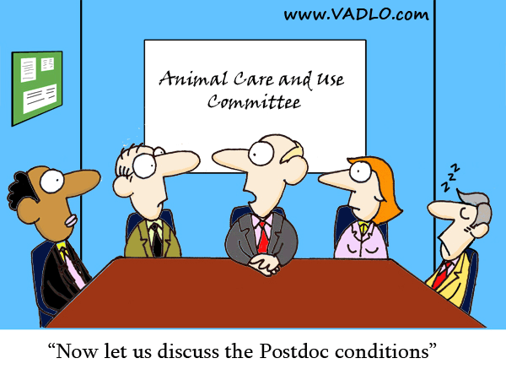
OFFICE OF ANIMAL WELFARE & IACUC
INTRODUCTION TO SPARKS2

Slide 39
OFFICE OF ANIMAL WELFARE & IACUC
IACUC
Principal Investigators
Approval Letters
Lab Inspections
Environmental Health Animal Contact
Accreditation Organizations
Training
Regulators:
USDA, OLAW, NIH /PHS, FDA, NSF etc.
Community & Public Interests
Complaints
Research Ethics, Compliance, IRB, & IACUC

Slide 40
OFFICE OF ANIMAL WELFARE & IACUC
Components of a Quality Animal Care and Use Program:
The Research Team
Institutional Official (IO)
Researchers
IACUC
Animal Care Staff (AV and technical staff)
Policies, Procedures, Resources and Facilities
Research Ethics, Compliance, IRB, & IACUC

Slide 41
OFFICE OF ANIMAL WELFARE & IACUC
Role of the IO
Be informed about the program
Be engaged in the program
Sustained and visible support
In a position to influence institutional priorities
Can assure sufficient monetary and personnel resources are allocated
Research Ethics, Compliance, IRB, & IACUC

Slide 42

OFFICE OF ANIMAL WELFARE & IACUC
Responsibilities of the IACUC
At least once every 6 months, review the research facility's program, inspect all of the animal facilities, including animal study areas/ satellite facilities, using USDA Regulations & The Guide as criteria.
Prepare reports of IACUC evaluations and submit them to the Institutional Official (IO)
Review and investigate legitimate concerns involving the care and use of animals at the Research Facility resulting from public complaints or from reports of non- compliance with PHS policy received from facility personnel or employees. Serious or continuing non-compliance must be reported to the Office Laboratory Animal Welfare (OLAW).
If noncompliance with PHS Policy is verified, the activity will be suspended; take corrective action and report to funding agency and USDA.
Research Ethics, Compliance, IRB, & IACUC

Slide 43
OFFICE OF ANIMAL WELFARE & IACUC
IACUC Forms:
New protocol submission
Addendums
Annual Renewals
Revised Protocols
Re-writes (Every 3 years)
Termination Form
Approval Letters
Research Ethics, Compliance, IRB, & IACUC
Notes:
Annual renewals- 1 page form in which we obtain funding information and total animals used for the previous year

Slide 44
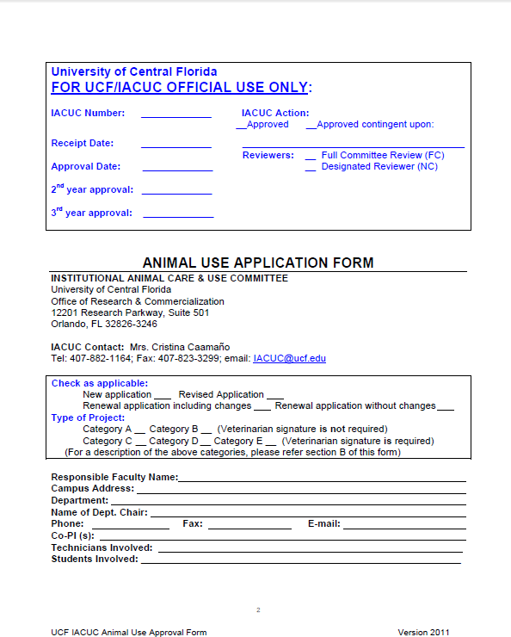
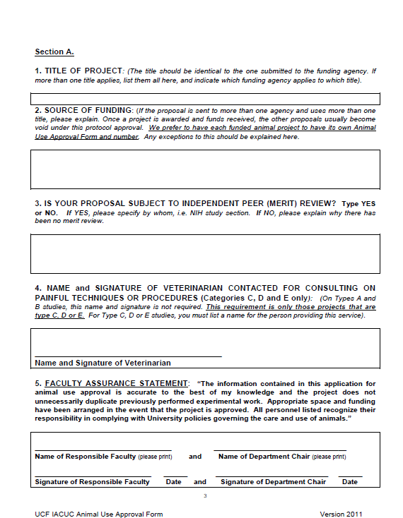
OFFICE OF ANIMAL WELFARE & IACUC
IACUC Protocol Application
Research Ethics, Compliance, IRB, & IACUC

Slide 45
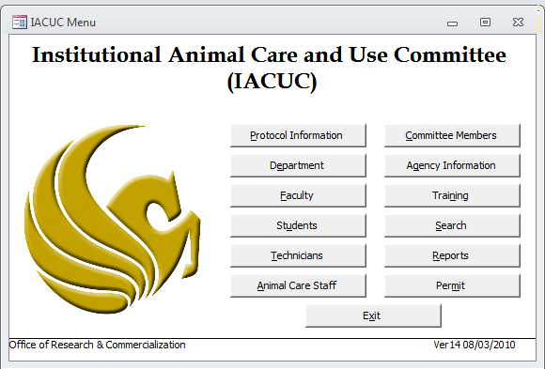
OFFICE OF ANIMAL WELFARE & IACUC
Database
Research Ethics, Compliance, IRB, & IACUC

Slide 46
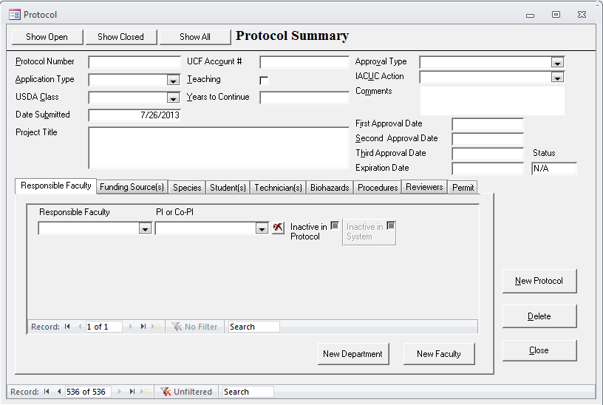
OFFICE OF ANIMAL WELFARE & IACUC
Research Ethics, Compliance, IRB, & IACUC

Slide 47
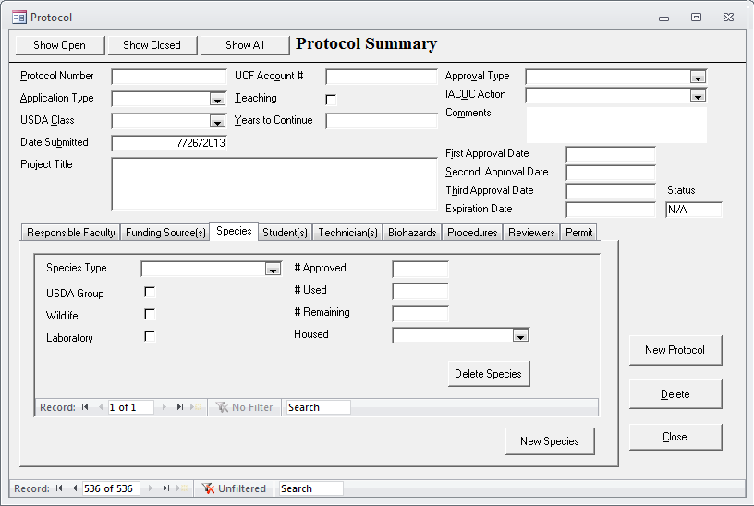
OFFICE OF ANIMAL WELFARE & IACUC
Research Ethics, Compliance, IRB, & IACUC

Slide 48
OFFICE OF ANIMAL WELFARE & IACUC
UCF and Federal Regulations require training and continuing education to ensure that all scientists, research technicians and other personnel involved in animal care, treatment, and use are qualified to perform their duties in the care and use of research animals.
In addition to the qualifications needed for their specific duties ALL personnel listed in the protocol must take IACUC Laboratory Animal Training Association (LATA) modules.
Research Ethics, Compliance, IRB, & IACUC
Notes:
“Occupational Health and Safety” is required for ALL personnel contacting animals

Slide 49
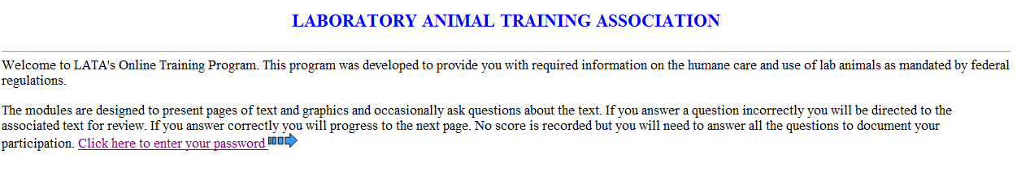
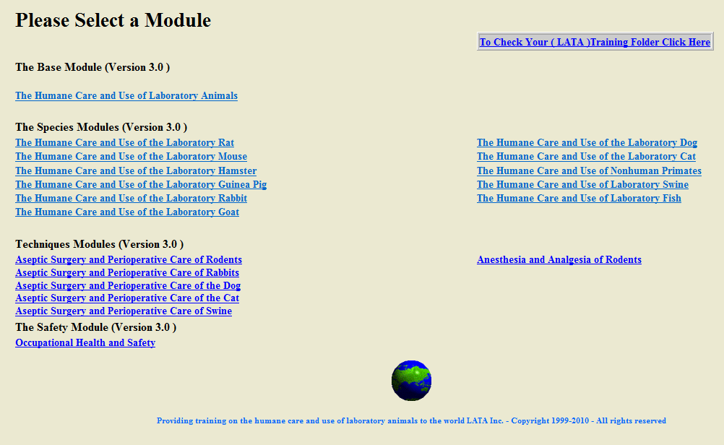
OFFICE OF ANIMAL WELFARE & IACUC
Research Ethics, Compliance, IRB, & IACUC

Slide 50
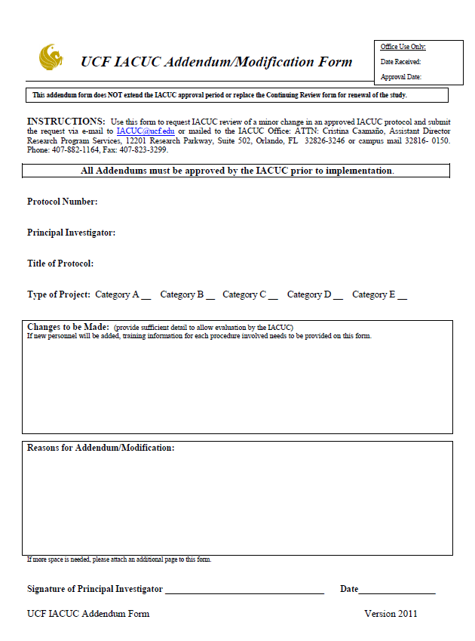
OFFICE OF ANIMAL WELFARE & IACUC
Research Ethics, Compliance, IRB, & IACUC

Slide 51
OFFICE OF ANIMAL WELFARE & IACUC
Significant changes (revised protocol)
Minor changes (addendum)
New invasive or potential invasive procedure
Change in drug or addition of new drug
Major increase in the number of animals
Increase of the amount of pain or distress
Change in anesthetic agent or analgesic
Change in post operative monitoring
Addition or removal of personnel
Title change
Funding agency
Change in drug dose
Minor increase in the number of animals
Change or addition of strain of animal
New or additional training
Minor procedures (ultrasounds, x-rays etc.)
Research Ethics, Compliance, IRB, & IACUC

Slide 52
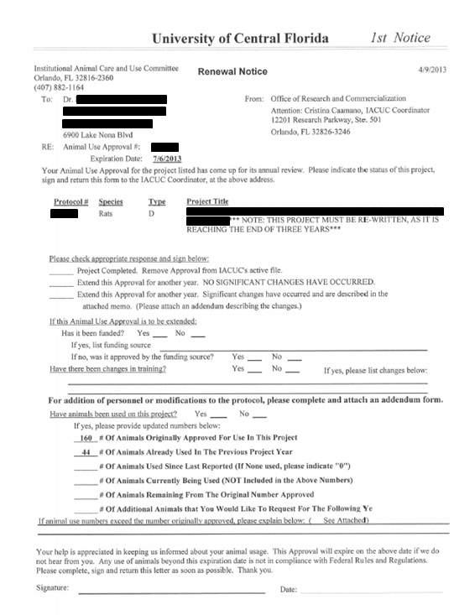
OFFICE OF ANIMAL WELFARE & IACUC
Research Ethics, Compliance, IRB, & IACUC

Slide 53
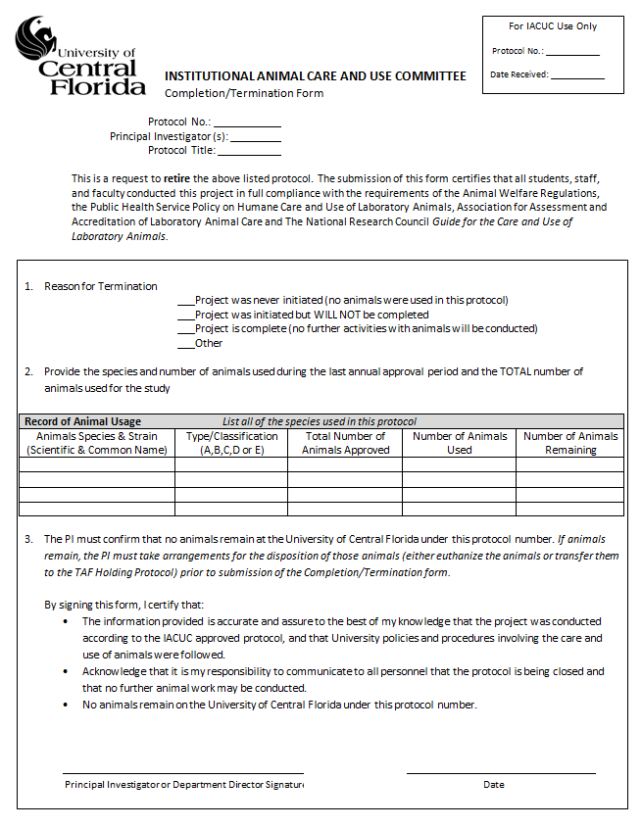
OFFICE OF ANIMAL WELFARE & IACUC
Research Ethics, Compliance, IRB, & IACUC

Slide 54
OFFICE OF ANIMAL WELFARE & IACUC
What are the methods of protocol review?
Only two methods can be used to review protocols for:
Initial review
Significant changes
Renewal review
Full committee review
Designated member review
Administrative review may be used to approve minor changes
Research Ethics, Compliance, IRB, & IACUC
Notes:
-Talk about IACUC protocols and addendums (the process- when we recv. them etc.)

Slide 55
OFFICE OF ANIMAL WELFARE & IACUC
What are the differences?
Full Committee Review (FCR)
Convened meeting of a quorum (face to face)
May request for modifications, approve or disapprove
Simple majority vote
Designated Member Review (DMR)
Two qualified members of the committee to review
All members are provided with the protocol for review and may request a FCR within a specified time period
They may request modifications, approve or disapprove
Research Ethics, Compliance, IRB, & IACUC
Notes:
FC- bi-monthly meetings or if by DR committee cannot agree on approval they can request for FCR

Slide 56
OFFICE OF ANIMAL WELFARE & IACUC
IACUC Actions:
Full Approval is given when the submitted protocol meets ALL of the committee’s requests and requirements.
To Table or Withhold Approval is an option when a submission does not meet basic requirements or acceptable standards.
Suspension can occur when a researcher is found to be in serious violation of methods previously approved by the committee.
Research Ethics, Compliance, IRB, & IACUC

Slide 57
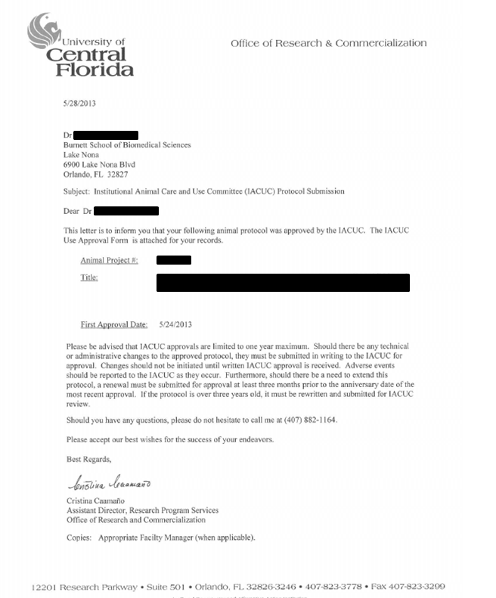
OFFICE OF ANIMAL WELFARE & IACUC
Research Ethics, Compliance, IRB, & IACUC

Slide 58
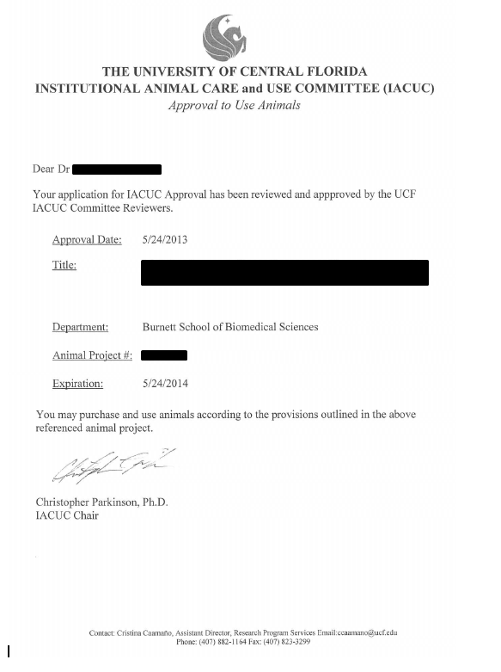
OFFICE OF ANIMAL WELFARE & IACUC
Research Ethics, Compliance, IRB, & IACUC

Slide 59
OFFICE OF ANIMAL WELFARE & IACUC
Reporting concerns for animal welfare
The University of Central Florida is committed to the humane care of the animals used in its research and institutional activities.
All claims made will be taken seriously and investigated by the IACUC committee.
No individual shall be discriminated against or be subject to any reprisal for reporting violations of regulations or standard.
*Anonymity Guaranteed
It is UCF policy that individuals reporting knowledge of improper animal use or concerns related to animal use and welfare at UCF are protected by the Whistleblower Act.
Research Ethics, Compliance, IRB, & IACUC

Slide 60

OFFICE OF ANIMAL WELFARE & IACUC
Full Accreditation
June 2011
Association for Assessment and Accreditation of Laboratory Animal Care
Research Ethics, Compliance, IRB, & IACUC

Slide 61
OFFICE OF ANIMAL WELFARE & IACUC
What is AAALAC International?
Mission
AAALAC International promotes the responsible treatment of animals in science through a voluntary accreditation program. For more than 45 years, the scientific community has actively—and voluntarily—participated in AAALAC's accreditation program. Participating institutions receive an independent, unbiased expert assessment, and those that meet or exceed applicable standards are awarded accreditation.
Research Ethics, Compliance, IRB, & IACUC

Slide 62
OFFICE OF ANIMAL WELFARE & IACUC
Accreditation and assessment for animal care and use programs.
Private non-profit organization
Completely voluntary and confidential programs.
Open to all institutions that use animals in research, teaching or testing.
International in scope – more than 700 institutions in 29 countries are accredited.
Research Ethics, Compliance, IRB, & IACUC

Slide 63
OFFICE OF ANIMAL WELFARE & IACUC
It symbolizes quality.
It promotes scientific validity.
It's a recruiting tool.
It demonstrates accountability (to the public, etc.).
Research Ethics, Compliance, IRB, & IACUC

Slide 64
OFFICE OF ANIMAL WELFARE & IACUC
It provides a confidential, external peer-review.
It impresses funding sources and partners.
It shows a real commitment to humane animal care.
Research Ethics, Compliance, IRB, & IACUC

Slide 65
OFFICE OF ANIMAL WELFARE & IACUC
Fun Fact!!
Which is more highly regulated
Animal Research or Human Research?
That’s right! Animal Research
Research Ethics, Compliance, IRB, & IACUC
Notes:
Animal Research- Since 1966

Slide 66

OFFICE OF ANIMAL WELFARE & IACUC
COMING SOON!!!!
Research Ethics, Compliance, IRB, & IACUC

Slide 67
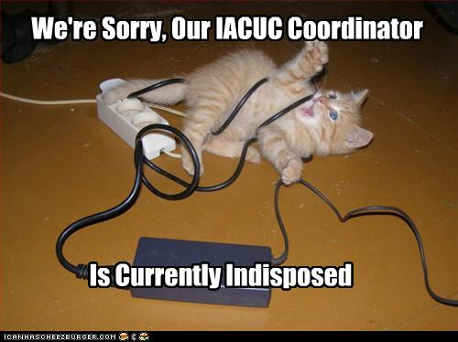
Questions or comments
OFFICE OF ANIMAL WELFARE & IACUC
Research Ethics, Compliance, IRB, & IACUC

Slide 68
OFFICE OF ANIMAL WELFARE & IACUC
Office of Research & Commercialization
Robert (Bob) Banks, BS, LATG
Associate Director, Research Program Services
Manager Ara Drive Research Facility (ADRF)
Formerly called the Wild Animal Facility (WAF)
Research Ethics, Compliance, IRB, & IACUC

Slide 69
OFFICE OF ANIMAL WELFARE & IACUC
Ara Drive Research Facility (ADRF)
Originally built to house non traditional laboratory animals ie. Wild animals
Conventional housing facility (non barrier)
ADRF has been housing laboratory research animals since 2006
We have housed projects studying ALS (Lou Gehrig's), Parkinson’s, Alzheimer's, Diabetes, Malaria, Anthrax, Plague, Hydrocephalus, Nano Sciences, Breast Cancer, Cervical Cancer, Brain Cancer, blood borne diseases, Eye Laser Surgery and others
Have accommodated transgenic mice (knock ins & knock outs) , rabbits, rats, & venomous and non venomous snakes since opening in 2006
Staffed by me, Bryan Kirk and Ryan Pabon
Research Ethics, Compliance, IRB, & IACUC

Slide 70
OFFICE OF ANIMAL WELFARE & IACUC
What do we do at the ADRF??
We facilitate funded and non fund research projects by providing 24 hour, 7 days per week, 365 days per year care for all research animals ( some mice > $1500 each) housed within the ADRF.
We ensure all animal projects housed with us meet the requirements of the IACUC, NIH & USDA
We observe all animals and animal rooms daily for any signs of illness, diseases, or distress and communicate directly with our AV, PI’s and/or their staff to ensure that the animals are house, maintained and used in a manner consistent with their IACUC protocol
We perform daily tasks to ensure that the research animals housed within are in as clean an environment as possible, and we monitor our cleanliness on a quarterly basis
We provide training as needed for PI’s, staff, and students to ensure that animals are being used and handled properly.
Why do we matter to ORC?
ORC receives overhead funds (which pay the light bills and salaries of our staff) from research grants that support these animal research projects.
We provide the means to support the research proposals that ORC processes and manage for the University
If we do our job properly we keep the IO=Tom O’Neal out of jail and UCF out of the news
Research Ethics, Compliance, IRB, & IACUC

Slide 71
OFFICE OF ANIMAL WELFARE & IACUC
Working Together
Animals are served best when all three
teams communicate and know what is
going on with their protocols.
Research Team
Animal Care Team
Veterinary Team
Compliance problems occur when these teams do not
communicate and just assume everyone else knows what
is going on.

Slide 72
OFFICE OF ANIMAL WELFARE & IACUC
Office of Research & Commercialization
Teresa Krisch, MS, CVT, LATG, CMAR, CPIA
Director of Transgenic Facilities at TAF & Nona
Research Ethics, Compliance, IRB, & IACUC

Slide 73
OFFICE OF ANIMAL WELFARE & IACUC
Research Program Services
Animal Care
3 animal facilities:
Transgenic Facility (TAF), Biology bldg. 20
Ara Drive Research Facility (ADRF), Ara drive (Formerly known as WAF on Neptune Dr.)
Vivarium at Lake Nona (NAF), Medical City
We provide husbandry and care for animals used by UCF Faculty to support their research
Research Ethics, Compliance, IRB, & IACUC

Slide 74
OFFICE OF ANIMAL WELFARE & IACUC
Research Program/ Services
Animal Care
The research being conducted at UCF encompasses a large variety of health issues: Lyme disease, diabetes, heart disease, mammary and pancreatic cancer, Parkinson’s disease, hypertension, neurological disorders, aging, and many more
Research Ethics, Compliance, IRB, & IACUC

Slide 75
OFFICE OF ANIMAL WELFARE & IACUC
Housing
Currently, only mice and rats are housed at UCF facilities
The animals are specific pathogen free and maintained in as sterile environment as possible to limit the number of variables to the research
At Nona and TAF, the animals are maintained in sterile ventilated cages and racks with enrichment items to promote natural behavior
It is the priority of the animal care team to ensure each animal’s health and comfort
Research Ethics, Compliance, IRB, & IACUC

Slide 76
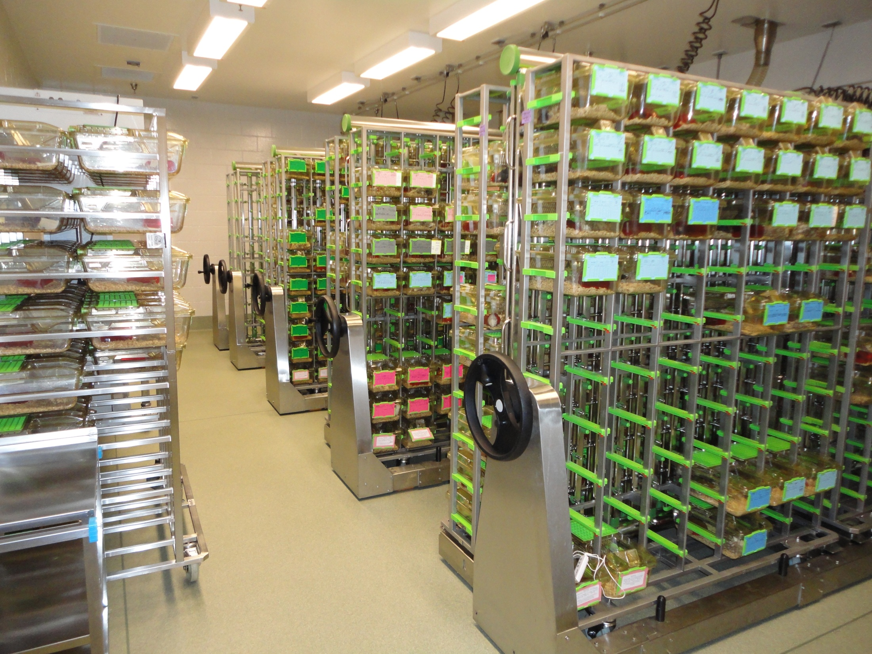

Slide 77
QUESTIONS or COMMENTS?

Slide 78

THANKS FOR JOINING US!
See you at the next session:
Pre-Award Services
August 14, 2013
ORC 2nd floor large (#211)

